Slide 1

Tap Me Plus One
111502563 林橋毅
111502538 蔡文綺

Slide 2
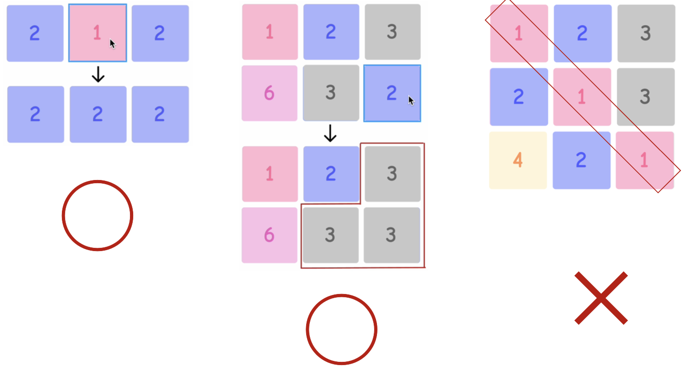
遊戲規則

Slide 3
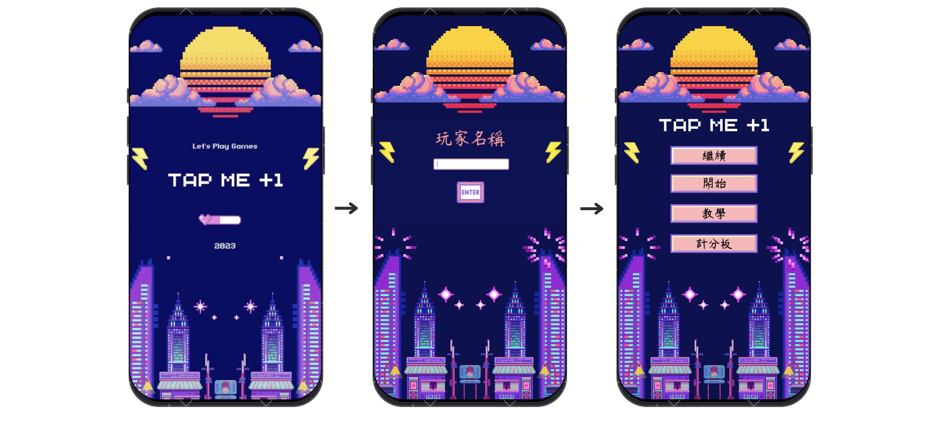
視窗介紹
初始畫面
設定名稱
主頁

Slide 4
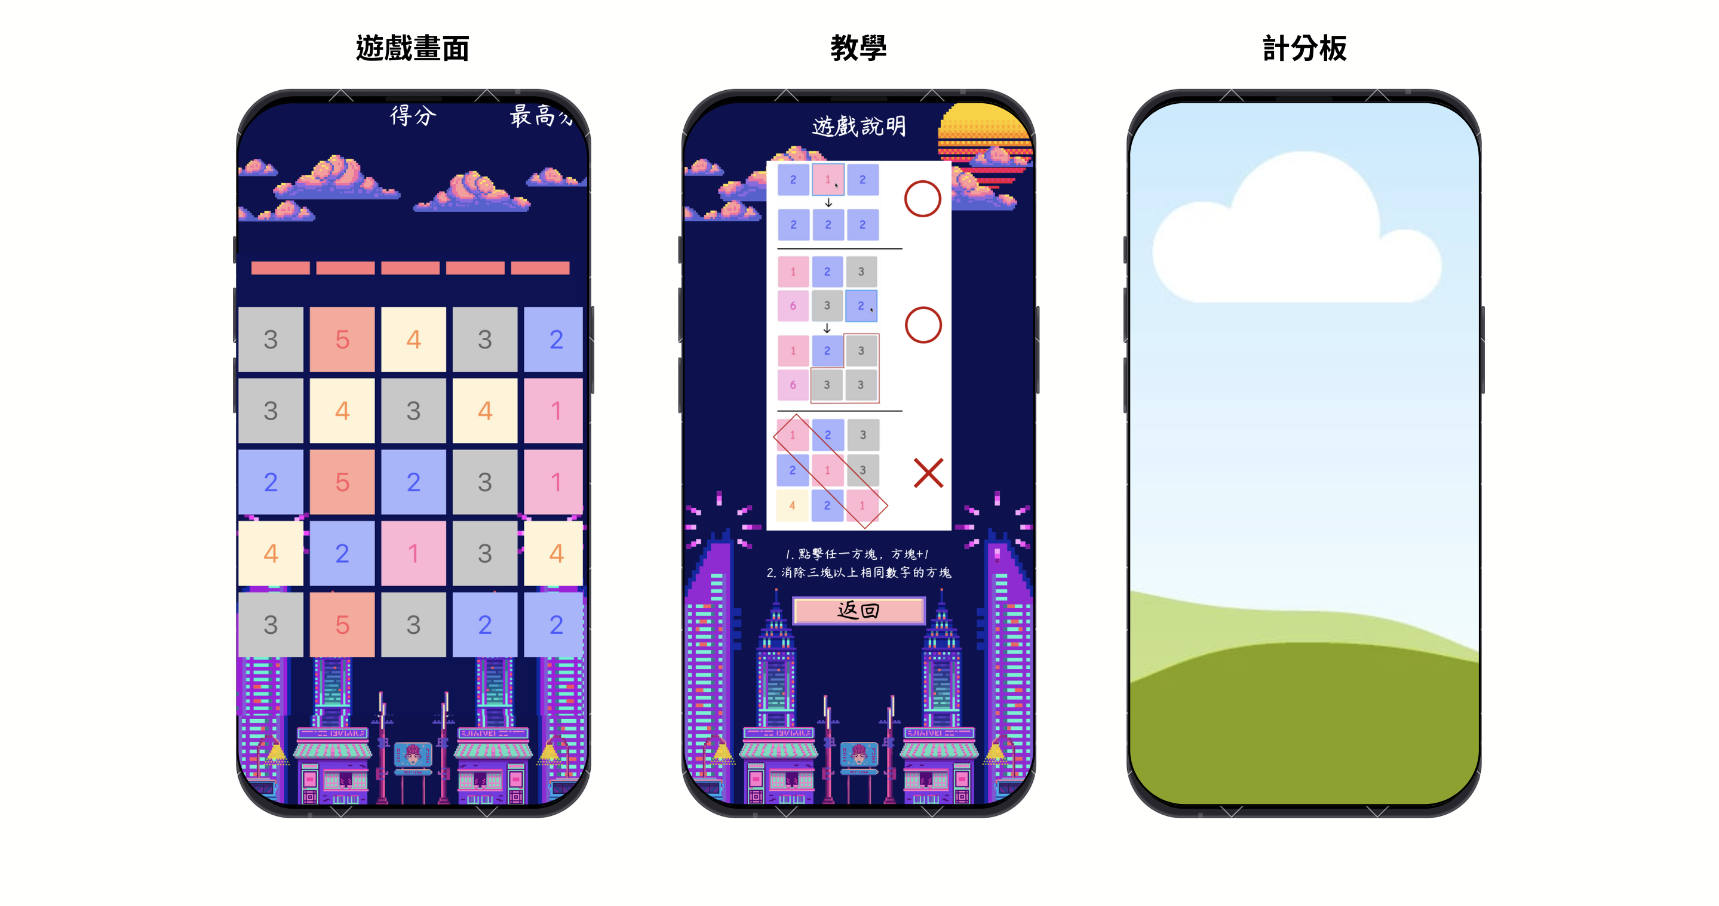
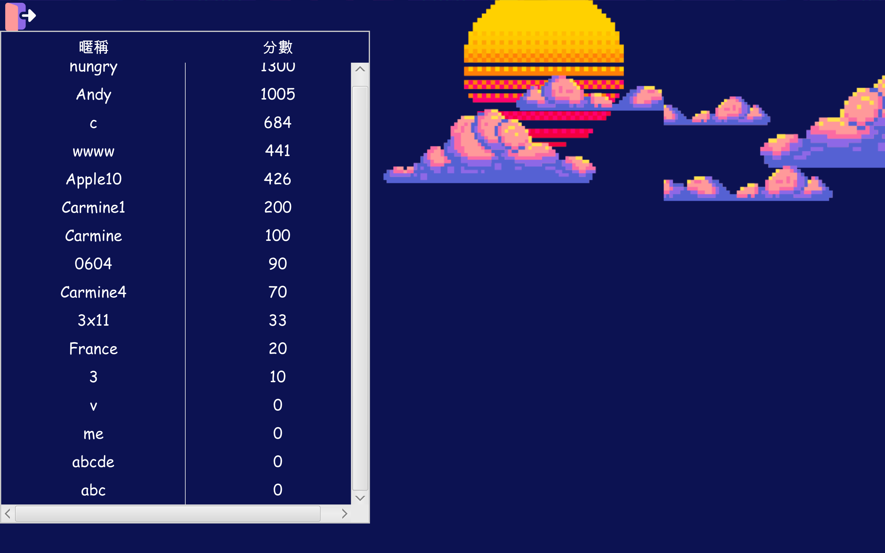
視窗介紹
遊戲畫面
遊戲說明
計分板

Slide 5
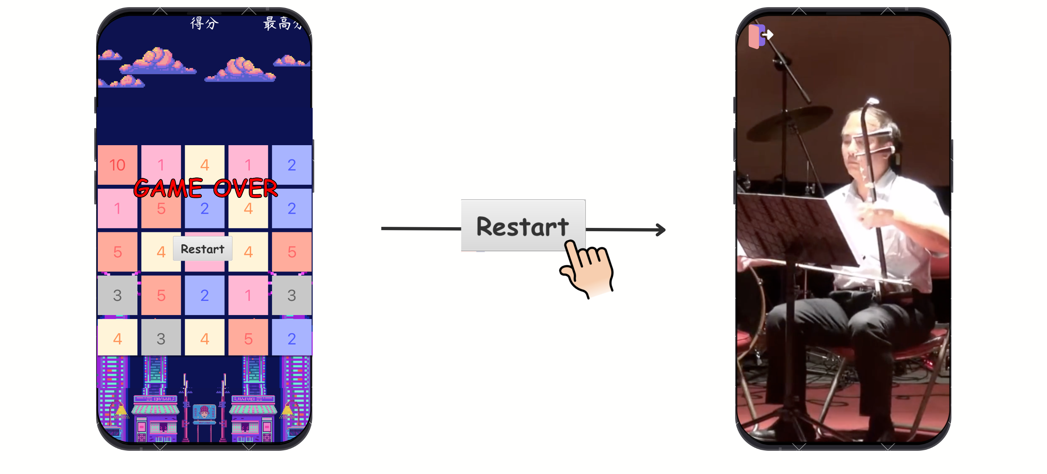
視窗介紹
Game Over 畫面
廣告時間

Slide 6
計分板
使用 TableView 與 dreamlo 服務
Simple-json 處理 API 回傳資料，並整理計分板

Slide 7
Flow Chart
等待點擊
BFS
回收方塊
新增方塊
掃描版面
有可合併的區塊

Slide 8
BFS Algorithm with Route
1 | 2 | 5 | 3 | 4
4 | 3 | 5 | 2 | 1
4 | 3 | 2 | 5 | 4
1 | 2 | 1 | 3 | 3
4 | 4 | 5 | 2 | 5
1 | 2 | 5 | 3 | 4
4 | 4 | 5 | 2 | 1
4 | 3 | 2 | 5 | 4
1 | 2 | 1 | 3 | 3
4 | 4 | 5 | 2 | 5
Queue: [1,1]

Slide 9
BFS Algorithm with Route
1 | 2 | 5 | 3 | 4
4 | 4 | 5 | 2 | 1
4 | 3 | 2 | 5 | 4
1 | 2 | 1 | 3 | 3
4 | 4 | 5 | 2 | 5
 | X
Queue: [1,0]

Slide 10
BFS Algorithm with Route
1 | 2 | 5 | 3 | 4
4 | 4 | 5 | 2 | 1
4 | 3 | 2 | 5 | 4
1 | 2 | 1 | 3 | 3
4 | 4 | 5 | 2 | 5
R | X
Queue: [2,0]

Slide 11
BFS Algorithm with Route
1 | 2 | 5 | 3 | 4
4 | 4 | 5 | 2 | 1
4 | 3 | 2 | 5 | 4
1 | 2 | 1 | 3 | 3
4 | 4 | 5 | 2 | 5
R | X
U
Queue:

Slide 12
BFS Algorithm with Route
1 | 2 | 5 | 3 | 4
4 | 4 | 5 | 2 | 1
4 | 3 | 2 | 5 | 4
1 | 2 | 1 | 3 | 3
4 | 4 | 5 | 2 | 5
R | X
U
Queue:

Slide 13
Finding route and animation
1 | 2 | 5 | 3 | 4
4 | 4 | 5 | 2 | 1
4 | 3 | 2 | 5 | 4
1 | 2 | 1 | 3 | 3
4 | 4 | 5 | 2 | 5
R | X
U

Slide 14
Finding route and animation
1 | 2 | 5 | 3 | 4
4 | 4 | 5 | 2 | 1
4 | 3 | 2 | 5 | 4
1 | 2 | 1 | 3 | 3
4 | 4 | 5 | 2 | 5
R | X
U

Slide 15
Finding route and animation
1 | 2 | 5 | 3 | 4
4 | 4 | 5 | 2 | 1
4 | 3 | 2 | 5 | 4
1 | 2 | 1 | 3 | 3
4 | 4 | 5 | 2 | 5
R | X
U

Slide 16
BFS Algorithm with Route
1 | 2 | 5 | 3 | 4
 | 5 | 5 | 2 | 1
 | 3 | 2 | 5 | 4
1 | 2 | 1 | 3 | 3
4 | 4 | 5 | 2 | 5

Slide 17
Padding
1 | 2 | 5 | 3 | 4
 | 5 | 5 | 2 | 1
 | 3 | 2 | 5 | 4
1 | 2 | 1 | 3 | 3
4 | 4 | 5 | 2 | 5
 | 2 | 5 | 3 | 4
 | 5 | 5 | 2 | 1
1 | 3 | 2 | 5 | 4
1 | 2 | 1 | 3 | 3
4 | 4 | 5 | 2 | 5

Slide 18
Add new Block
1 | 2 | 5 | 3 | 4
3 | 5 | 5 | 2 | 1
1 | 3 | 2 | 5 | 4
1 | 2 | 1 | 3 | 3
4 | 4 | 5 | 2 | 5

Slide 19
Scan and BFS… until no block can combine
1 | 2 | 5 | 3 | 4
3 | 5 | 5 | 2 | 1
1 | 3 | 2 | 5 | 4
1 | 2 | 1 | 3 | 3
4 | 4 | 5 | 2 | 5
1 | 2 | 5 | 3 | 4
3 | 5 | 5 | 2 | 1
1 | 3 | 2 | 5 | 4
1 | 2 | 1 | 3 | 3
4 | 4 | 5 | 2 | 5

Slide 20
Scan and BFS… until no block can combine
1 | 2 |  | 3 | 4
3 |  | 6 | 2 | 1
1 | 3 | 2 | 5 | 4
1 | 2 | 1 | 3 | 3
4 | 4 | 5 | 2 | 5
1 | 1 | 5 | 3 | 4
3 | 2 | 6 | 2 | 1
1 | 3 | 2 | 5 | 4
1 | 2 | 1 | 3 | 3
4 | 4 | 5 | 2 | 5
No C.C that size >= 3

Slide 21
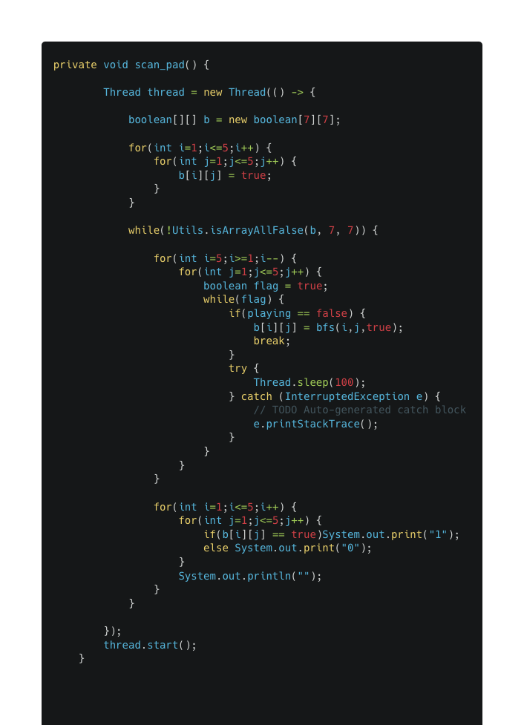
Detect animation playing
需要等待動畫播放完才能讓玩家點擊下一個方塊
使用 Thread 監控動畫狀態，進入動畫則將 flag = 1, vice versa
使用 Thread.sleep() 避免 CPU 使用率過高

Slide 22
GitHub Page
https://github.com/qiaoyi213/TapMePlusOne

Slide 23
Reference
Json-simple: https://github.com/fangyidong/json-simple
Canva template by @cristianalexteam

